Slide 1
The Research Process
Coming to Terms

Slide 2
A Journey

Slide 3
The Research Process
A journey
Two important decisions to make in a research journey
What you want to find out about
Or what research questions (problems) you want to find answers to.
How to go about finding their answers

Slide 4
Process of Knowing
Tenacity – hold on to beliefs because you always thought they were true
Reference to Authority – believe something is true because it comes from someone you respect
Priori Method – believe something is true because it appeals to common sense
Scientific Method – truth is based on objective, public, and published information

Slide 6
Taking the Path
There are steps through which you must pass in order to find answers.
The path to finding answers to your research questions constitutes research methodology.
At each step, you are required to choose from a multiplicity of methods, procedures and models of research methodology which will help you achieve your objectives

Slide 7
Common views of the Research Process
Blaxter et al. (2006: 8–9) identify four (4) common views of the research process:
Sequential
Generalized
Circulatory
Evolutionary

Slide 8
Common views of the Research Process
Sequential
Simples view of all
A series of activities are performed one after another as a ”fixed, linear series of stages”.
Systematic process model of seven unique sequential steps (Sharp et al. (2002: 17).)

Slide 9
Common views of the Research Process
Systematic process model (Sharp et al. (2002: 17).)
Identify the broad area of study.
Select a research topic.
Decide on an approach.
Plan how you will perform the research.
Gather data and information
Analyse and interpret these data.
Present the results and findings.
Sharp et al. admit that repetition and cycles may take place during this process. How and when this repetition takes place is not explicitly defined.

Slide 10
Common views of the Research Process
Greenfield (1996:7) breaks the research process into four steps:
Review the field – i.e. Perform a literature review.
Build a theory – based on your understanding and interpretaions of the field.
Test the theory – does it work?
Reflect and integrate – i.e., update your ideas based on your ’tests’ and contribute newfound knowedge to others.

Slide 11
Common views of the Research Process
Generalized
Identical to sequential process in that defined sequence of activities is performed but recognizes that not all stages are applicable and some may require performing in different ways depending on the nature of research.
Thus, identifies alternatives routes that may be taken at different stages.

Slide 12
Common views of the Research Process
Circulatory
Recognizes that any research is really only part of a continuous cycle of discovery and investigation.
uncovering more questions than answers, hence research process can begin again by attempting to answer this newfound questions.
Experiences of research might lead to revisit or reinterpret earlier stages
Also permits the research process to be joined at any point and recognizes that the process is never-ending.
E.g. Rudestam and Newton’s Research Wheel (2007: 5)

Slide 13
Common views of the Research Process
Evolutionary
Takes the circulatory interpretation one step further and recognizes that research must evolve and change over time
The outcomes of each evolution impact on later ones to a greater or lesser extent.

Slide 14
Common views of the Research Process
Research Process as defined by Orna and Stevens (1995: 11)
A process that is circulatory at the top level and evolutionary within the main search/investigation stage of the process

Slide 15
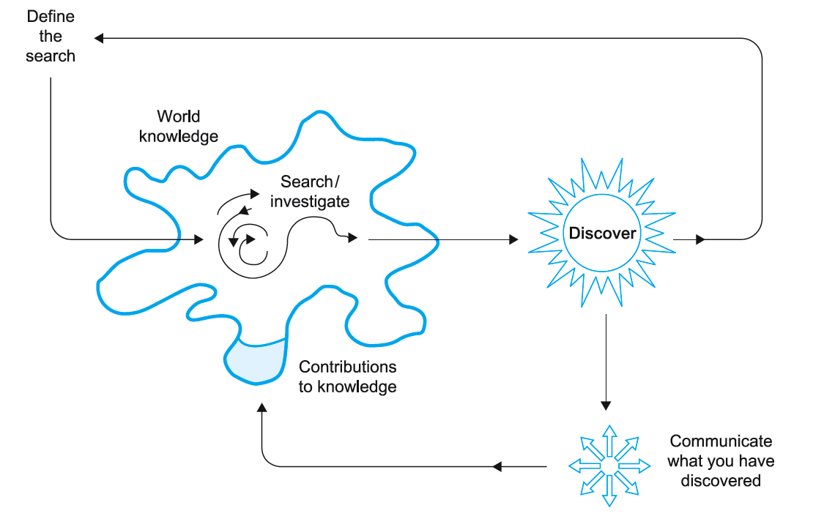

Slide 16
Common views of the Research Process
Orna and Stevens identify this search definition as an attempt to answer the following questions:
What am I looking for?
Why am I looking for it?
How shall I set about it?
Where shall I start looking?

Slide 17
Research Process (Kothari, 2004)
I. Define Research Problem
II. Review the Literature
(review concepts and theories, review previous research findings)
III. Formulate Hypotheses
IV. Prepare the Research Design
Collect data
Analyze data
Interpret and Report Data

Slide 18
Steps in Research Process
Formulating the Research Problem
Extensive Literature Review
Developing the Objectives
Preparing the Research Design including Sample Design
Collecting Data
Analysis of Data
Generalization and Interpretation
Preparation of the Report or Presentation of Results

Slide 19
Step 1. Formulating the research problem
Most crucial step in the research process
Main function is to decide what you want to find out about.
The way you formulate a problem determines almost every step that follows.

Slide 20
Formulating a Research Problem

Slide 21
The Research Problem
Conducted because of a problem that needs to be addressed, question to be answered, and knowledge gap that should be filled.
Common mistake is to state titles then try to identify the components of the title.
Title can be reworded even after the conduct of the study, but the problem cannot be changed. A change in the problem means a change in the entire study.

Slide 22
SMART
Five characteristics to consider as bases in stating problems or objectives
Specific
Measurable
Attainable
Realistic
Time-bound

Slide 23
Problem Statement
Stated clearly in question form
Should imply possibilities of empirical testing
Statement of the problem can be a combination of descriptive and inferential questions.

Slide 24
Problem Statement
Descriptive questions – elicits responses explained through means, frequencies, ranks, SD and other descriptive statistical tools
Inferential questions – link together one or more descriptive questions by asking differences or relationship among the variables found in the descriptive questions.

Slide 25
Problem Statement (Sample1)
The study is an attempt to answer the following questions:
What is the computer literacy level of the respondents in terms of the following indicators?:
Number of hours of computer trainings
Number of computer software used
Score in the test on computer technology

Slide 26
Problem Statement (Sample1)
Is the computer literacy level of the respondents related to the following characteristics?:
Age
Gender
Length of service

Slide 27
Problem Statement (Sample2)
Is there a difference in the income derived from the livelihood projects between program beneficiaries and non-beneficiaries?
Is there a relationship between the adequacy of program inputs with the expected outputs of the program?

Slide 28
In statistical analysis,
difference and relationship serve the same purpose because if the program beneficiaries and non-beneficiaries do not differ in income, it means that the variable income from livelihood projects is not related to the classification of the respondents whether beneficiaries or non-beneficiaries.

Slide 29
In natural sciences (and in applied sciences), research problems are stated in infinitive form as objectives of the study.
(Example)
The study will be conducted to determine the growth and yield response of hybrid rice to different levels of nitrogen fertilizer. Specifically, the study aims to:

Slide 30
Determine the agronomic characteristics of PSB Rc-72H Mestizo hybrid rice in terms of the following parameters:
Growth components
Number of days to flowering
Number of days to maturity
Plant height at maturity
Yield components
Average number of productive tillers per hill
Average length of panicles at maturity
Average number of grains per panicle
Average number of filled grains per panicle
Percent of filled grains per panicle
Average weight of 1000 seeds
Average grain yield per hectare
Find out which of the levels of nitrogen fertilizer gives the highest yield in tons per hectare

Slide 31
Criteria for Choosing a Topic
Importance and urgency
Interesting
Researchability
Relevance and moral implication
Budgetary and time requirements
Novelty

Slide 32
Sources of Research Problem
Researcher’s specialization
Curiosity and creative ideas of the researcher
Recommendations from theses; dissertations and published journals
Research and development thrusts of R&D institutions

Slide 33
Formulating Research Hypothesis
Educated guess
Conjectural statement about relationship between two or more variables
Needed when the research objective or problem statement calls for determining relationship between variables

Slide 34
Is the computer literacy level of the respondents related to the following characteristics?:
Age
Gender
Length of service
What is the relationship between the computer literacy level and each of the following characteristics of the respondents?:
Age
Gender
Length of service

Slide 35
Is there a relationship between the computer literacy level and each of the following characteristics of the respondents?:
Age
Gender
Length of service
Are the following variables associated with the computer literacy level of the respondents?:
Age
Gender
Length of service

Slide 36
Hypothesis
Types
Null Hypothesis (H₀)
Research (alternative) Hypothesis (H₁ or Ha )
Is there a relationship between the computer literacy level and each of the following characteristics of the respondents?:
Age
Gender
Length of service

Slide 37
Hypothesis (Sample)
Null Hypothesis
There is no relationship between the computer literacy level and each of the following characteristics of the respondents:
Age
Gender
Length of service

Slide 38
Hypothesis (Sample)
Research (alternative) Hypothesis
There is relationship between the computer literacy level and each of the following characteristics of the respondents:
Age
Gender
Length of service

Slide 39
Hypotheses

Slide 40
Hypothesis
Educated guess
Its most important role is to reflect the general problem statement.
Types:
null hypothesis
research hypothesis

Slide 41
Null Hypothesis (H₀)
Statement of equality
It acts as a starting point and a benchmark against which that actual outcomes of a study will be measured
Example: Average scores of 9th graders and 12th graders on the ABC memory test
H₀: No difference in the scores of 9th graders and 12th graders on the ABC memory test

Slide 42
Research Hypothesis (H₁)
Statement of inequality
There can be more than one research hypothesis for any one null hypothesis
Example: Average scores of 9th graders and 12th graders on the ABC memory test
H₁: Difference in the scores of 9th graders and 12th graders on the ABC memory test

Slide 43
Types of Research Hypothesis
Non-directional
Directional
Posits no direction to the inequality (“different from”)
Example: The average score of 9th graders is different from the average score of 12th graders on the ABC memory test
Posits a direction to the inequality (“more than”, “less than”)
Example: The average score of 9th graders is greater than the average score of 12th graders on the ABC memory test

Slide 44
Purposes of Research Hypothesis
Hypothesis to be tested directly as one step in the research process.
Results of this test are compared with what is expected by chance alone to see which of the two explanations is the more attractive one for observed differences between groups.

Slide 45
Purpose of Research Hypothesis (cont’d)
Do not prove the research hypothesis.
Rather than setting out to prove anything, always set out to test the research.

Slide 46
Null Hypothesis v. Research Hypothesis
Null Hypothesis
There is no relationship between variables.
It always refer to the population
It must be indirectly tested
It is always stated in Greek symbols
It is an implied hypothesis
Research Hypothesis
There is a relationship between variables.
It always refers to the sample
It must be directly tested
It is always stated in Roman symbols
It is an explicit hypothesis

Slide 47
What Makes a GOOD Hypothesis?
Stated in a declarative form
Posits an expected relationship between variables
Reflect a theory or a body of literature upon which they are based
Brief and to the point
Testable

Slide 48
All About Variables

Slide 49
Variables
Represent a class of outcomes (characteristic of a unit of observation) that can take more than one value.
Examples: hair color red, brown, black, blond
height short, tall, 5’3”, 6’1”
weight heavy, light, 128 lbs., 150 lbs.
The more precisely that a variable is measured, the more useful the measurement is.
Notes:
simply, it is an attribute or characteristic in which individuals differ.
Name of variable possible values
Gender male, female
Civil status single, married, widow, separated, divorced
Economic status low income, middle income, high income
Performance rating outstanding, vs, s, fair
It is up to the researcher to define the values of the variable in his own way.
When a description or procedure for determining the value of variable is clearly specified, the variable is said to be operationally defined. Different individuals give different definitions for a variable.

Slide 50
Data and Observed Values
When the value of a variable is observed and recorded, it is known as an observed value.
The set of observed values is called data.
Notes:
simply, it is an attribute or characteristic in which individuals differ.
Name of variable possible values
Gender male, female
Civil status single, married, widow, separated, divorced
Economic status low income, middle income, high income
Performance rating outstanding, vs, s, fair
It is up to the researcher to define the values of the variable in his own way.
When a description or procedure for determining the value of variable is clearly specified, the variable is said to be operationally defined. Different individuals give different definitions for a variable.

Slide 51
Qualitative and Quantitative Data
Qualitative data – values of variables expressed in words or statements. Also called categorical data.
Examples: gender educational qualification
ethnic groups sibling order
civil status
Notes:
simply, it is an attribute or characteristic in which individuals differ.
Name of variable possible values
Gender male, female
Civil status single, married, widow, separated, divorced
Economic status low income, middle income, high income
Performance rating outstanding, vs, s, fair
It is up to the researcher to define the values of the variable in his own way.
When a description or procedure for determining the value of variable is clearly specified, the variable is said to be operationally defined. Different individuals give different definitions for a variable.

Slide 52
Qualitative and Quantitative Data
Quantitative data – values of variables expressed in numerical terms (either counted or measured). Also called numerical data.
Examples: age
economic status
number of live births
Notes:
simply, it is an attribute or characteristic in which individuals differ.
Name of variable possible values
Gender male, female
Civil status single, married, widow, separated, divorced
Economic status low income, middle income, high income
Performance rating outstanding, vs, s, fair
It is up to the researcher to define the values of the variable in his own way.
When a description or procedure for determining the value of variable is clearly specified, the variable is said to be operationally defined. Different individuals give different definitions for a variable.

Slide 53
Types of Variables
Discrete
Continuous
Dependent
Independent
Control
Extraneous
Moderator

Slide 54
Discrete and Continuous Variables
Discrete
Continuous
Can take only a finite number of possible values within a limited range of values
Example.
number of female students in a class
number of male mayors in a province
Variable that can take an infinite number of possible values within a range.
Example.
weight of babies born
cost of gasoline
time it takes to finish a test

Slide 55
Dependent and Independent Variables
Dependent
Independent
Represent the measure that reflects the outcomes of a research study
Sensitive to changes in the different levels of the independent variable
Represent the treatments or conditions that the researcher has either direct or indirect controls over to test their effects on a particular outcome
Independent of any other variable that is being used in the same study

Slide 56
Dependent Variable
Type of variable that is measured to see whether the treatment or manipulation of the independent variable had an effect
Example: Effect of parental involvement in school on children’s grades
Dependent variable: Children’s grades

Slide 57
Dependent Variable (cont’d)
Other terms for dependent variables:
Outcome variable
Results variable
Criterion variable

Slide 58
Independent Variable
Type of variable that is manipulated to examine its impact on a dependent variable
Independent variables must take on at least two levels on values.
Example: Age differences in stress for people ages 30-39, 40-49 and 50-59
Independent variable: Age, 3 levels (30-39, 40-49, 50-59)

Slide 59
Independent Variable (cont’d)
Other terms for independent variables:
Treatment variable
Factor
Predictor variable

Slide 60
Independent Variables (cont’d)
When researchers are not interested in looking at the effects of one thing on another, but only in how variables may be related, there are no independent variables.
Example: Relationship between that amount of time a father spends with his children and his job performance

Slide 61
Independent & Dependent Variables
Some examples of dependent and independent variables in scientific experiments:
A scientist studies the impact of a drug on cancer.
A scientist studies the impact of withholding affection on rats.
A scientist studies how many days people can eat soup until they get sick.
If a scientist conducts an experiment to test the theory that a vitamin could extend a person’s life-expectancy.
If a researcher studies the effect of the amount of information remembered. Source: http://examples.yourdictionary.com/independent-and-dependent-variable-examples.html#48vEMdWXDyQdQzVJ.99

Slide 62
Factorial Design
Experiments that include more than one independent variable

Slide 63
Confounding Variables
Variables that compete to explain the effects

Slide 64
Control Variable
Type of variable that is related to the dependent variable, the influence of which needs to be removed
Example: Relationship between reading speed and comprehension
Control variable: Intelligence
Reason: Intelligence is related both to reading speed and comprehension

Slide 65
Extraneous Variables
Type of variable that is related to the dependent variable or independent variable that is not part of the experiment
These variables have unpredictable impact upon the dependent variable.
Example: Effects of television watching on achievement
Extraneous variable: Television programs
Reason: Programs may have positive or negative impacts on achievement

Slide 66
There are four types of extraneous variables:
1. Situational Variables
These are aspects of the environment that might affect the participant’s behavior, e.g. noise, temperature, lighting conditions, etc. Situational variables should be controlled so they are the same for all participants.
Standardized procedures are used to ensure that conditions are the same for all participants. This includes the use of standardized instructions

Slide 67
four types of extraneous variables
2. Participant / Person Variable
This refers to the ways in which each participant varies from the other, and how this could affect the results e.g. mood, intelligence, anxiety, nerves, concentration etc.
For example, if a participant that has performed a memory test was tired, dyslexic or had poor eyesight, this could effect their performance and the results of the experiment. The experimental design chosen can have an affect on participant variables.
Situational variables also include order effects that can be controlled using counterbalancing, such as giving half the participants condition 'A' first, while the other half get condition 'B' first. This prevents improvement due to practice, or poorer performance due to boredom.
Participant variables can be controlled using random allocation to the conditions of the independent variable.

Slide 68
four types of extraneous variables
3. Experimenter / Investigator Effects
The experimenter unconsciously conveys to participants how they should behave - this is called experimenter bias.
The experiment might do this by giving unintentional clues to the participants about what the experiment is about and how they expect them to behave. This affects the participants’ behavior.
The experimenter is often totally unaware of the influence which s/he is exerting and the cues may be very subtle but they may have an influence nevertheless.
Also, the personal attributes (e.g. age, gender, accent, manner etc.) of the experiment can affect the behavior of the participants.

Slide 69
four types of extraneous variables
4. Demand Characteristics
these are all the clues in an experiment which convey to the participant the purpose of the research.
Participants will be affected by: (i) their surroundings; (ii) the researcher’s characteristics; (iii) the researcher’s behavior (e.g. non-verbal communication), and (iv) their interpretation of what is going on in the situation.
Experimenters should attempt to minimize these factors by keeping the environment as natural as possible, carefully following standardized procedures. Finally, perhaps different experimenters should be used to see if they obtain similar results.

Slide 70
Example:
Measure the effects of alcohol on driving ability:
Extraneous variables:
Familiarity with the car
Familiarity with the test
Used to drinking (different effect of alcohol)
Full stomach

Slide 71
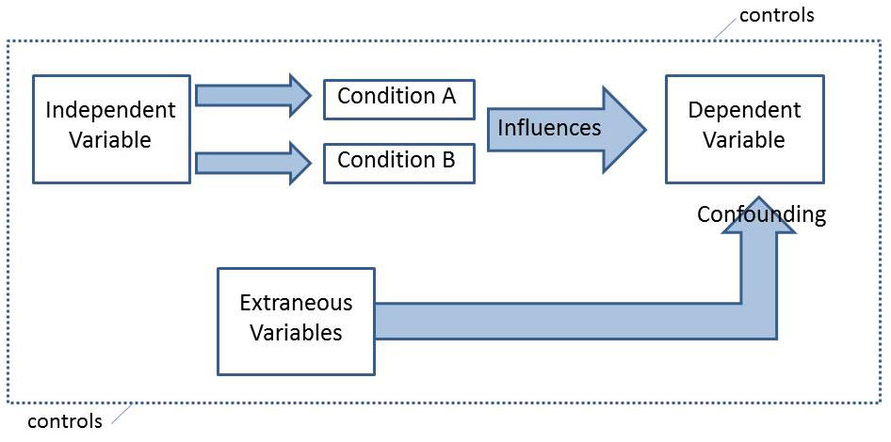
Extraneous Variables

Slide 72
Moderator Variable
Type of variable that is related to the variables of interest (independent and dependent), masking the true relationship between the independent and dependent variables
Example: Relationship between crime rate and ice cream consumption
Moderator variable: Temperature
Reason: Temperature must be observed because it moderates the relationship

Slide 73
Level of Measurement
Measurement – refers to assigning numbers to objects, persons or events based on a predetermined set of rules.

Slide 74
Level of Measurement
Four (4) Types of Scale of Measurement
Nominal Scale – if the measurement tells only what class a unit falls in with respect to a characteristic.
Examples: sex Civil status
Ethnic origin employment status
Educational qualification
Ordinal Scale – tells us that one unit has more of the characteristic than that of another unit.
Examples: mental ability
score in a college entrance test
score in a pageant

Slide 75
Level of Measurement
Four (4) Types of Scale of Measurement
Interval Scale – if the measurement tells us that one unit differs by a certain amount of the characteristic from another unit.
Ratio Scale – if the measurement tells us that one unit has so many times as much of the characteristic than that of another unit.
It is possible that examples for both interval and ratio scales are the same.

Slide 76
Samples and Populations

Slide 77
Samples and Populations
The larger group is referred to as a population.
The smaller group selected from a population is referred to as a sample.
Samples should be selected from a population in such a way that you maximize the likelihood that the sample represents the whole population.

Slide 78
Samples and Populations (cont’d)
The most important implication of ensuring the similarity between the two is that, once the research is finished, the results based on the sample can be generalized to the population.

Slide 79
Generalizability
When the sample does represent the whole population, the result are said to be generalizable or to have generalizability.

Slide 80
Concept of Significance

Slide 81
Significance
Measure of how much work a researcher is willing to take when reaching a conclusion about the relationship between variables

Slide 82
Statistical Significance
Degree of risk a researcher is willing to take that a null hypothesis will be rejected
Calculated as the probability that an effect observed in a research study is occurring because of chance

Slide 83
Statistical Significance
Usually expressed as a P-value.
The smaller the P-value, the less likely it is that the results are due to chance (and more likely that the results are true). Researchers generally believe the results are probably true if the statistical significance is a P-value less than 0.05 (p < .05)

Slide 84
The Research Process
Coming to Terms

